Slide 1

Project Designing a Maya Number System Adder Subtractor with 7 Segment Display
Presented By :
Md. Abdullah Al Rafi
2020-1-80-068
Department of Electrical and Electronic Engineering
Shohidul Islam Remon
2020-1-80-076
Department of Electrical and Electronic Engineering
Presented To,
Md Rafiul Abdussami
Senior Lecturer
Department of Electrical and Electronic Engineering

Slide 2
Procedure to Follow
Determining the resolution : The Adder/Subtractor circuit will consist on Two 5 bit BCM(Binary Coded Maya). The 5 Bit output will also give a 6th bit Carry which will be considered for the output in Decimals with two 7 Segment display.
Adder/ Subtractor : The Adder/Subtractor change is done manually by the operator. The Variable X will determine whether the circuit is Adder(X=0) or Subtractor(X=1)
Input : The input is given through Logic State. Inputs asre A0(MSB),A1,A2,A3,A4(LSB) and B0(MSB), B1,B2,B3,B4(LSB).
Primary Output : The primary output will be a 5 bit binary number with Carry. S0(MSB),S1,S2,S3,S4(LSB),Carry.
Displaying in Decimal : The display is chosen to be two 7 segment display(Common Cathode) giving output in decimal values. S0(MSB),S1,S2,S3,S4(LSB),Carry are taken as F,E,D,C,B,A.
Truth Table : A truth Table is constructed according to 7 segment input and A,B,C,D,E,F as input. The truth table is divided into two type of output for 10’s and 1’s as per two display.
Karnaugh map : Karnaugh map is used to simplify the SOP
Construction : Proteus 7.7 application is used to construct the circuit.
Limitation : The Circuit ca only output from 0 to 38.

Slide 3
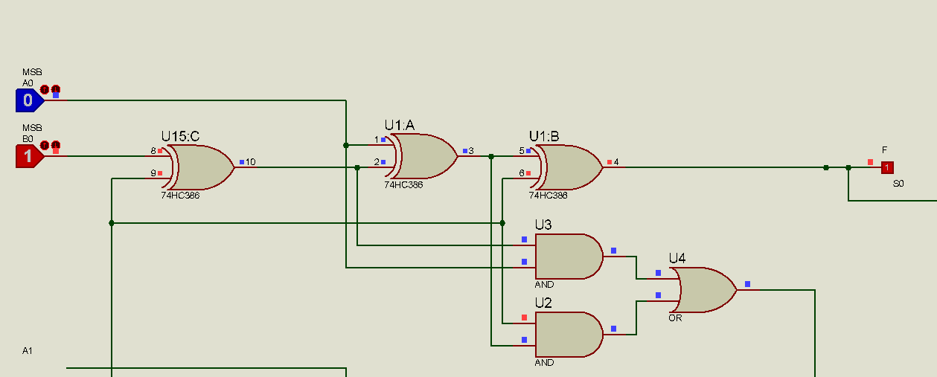
Adder/ Subtractor: The Adder/Subtractor change is done manually by the operator.
The Variable X will determine whether the circuit is Adder(X=0) or Subtractor(X=1)

Slide 4
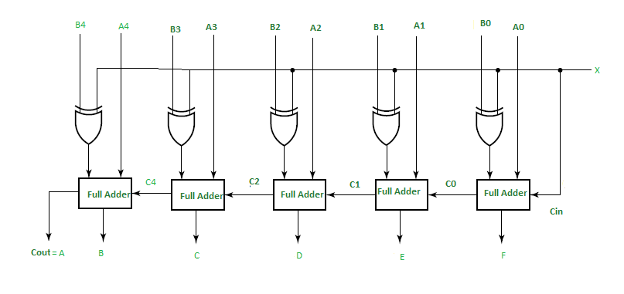
Input : The input is given through Logic State. Inputs asre A0(MSB),A1,A2,A3,A4(LSB) and B0(MSB), B1,B2,B3,B4(LSB).
Primary Output : The primary output will be a 5 bit binary number with Carry. S0(MSB),S1,S2,S3,S4(LSB),Carry.

Slide 5
Displaying in Decimal: The display is chosen to be two 7 segment display(Common Cathode) giving output in decimal values. S0(MSB),S1,S2,S3,S4(LSB),Carry are taken as F,E,D,C,B,A.

Slide 6
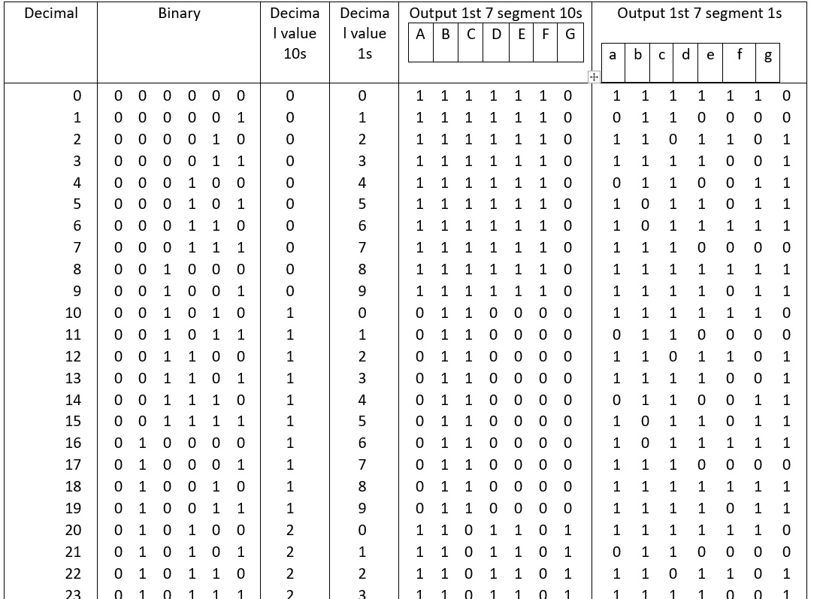
Truth Table : A truth Table is constructed according to 7 segment input and A,B,C,D,E,F as input. The truth table is divided into two type of output for 10’s and 1’s as per two display.

Slide 7
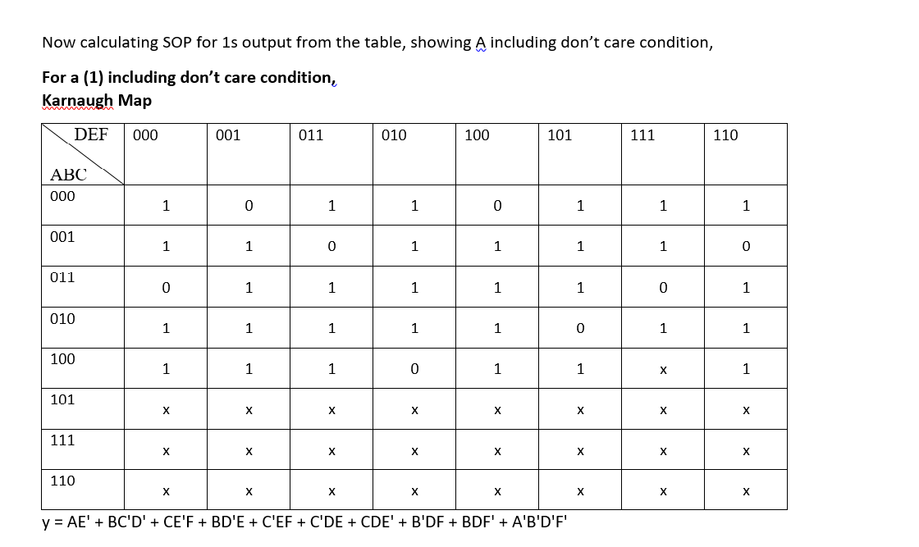
Karnaugh MAP

Slide 8
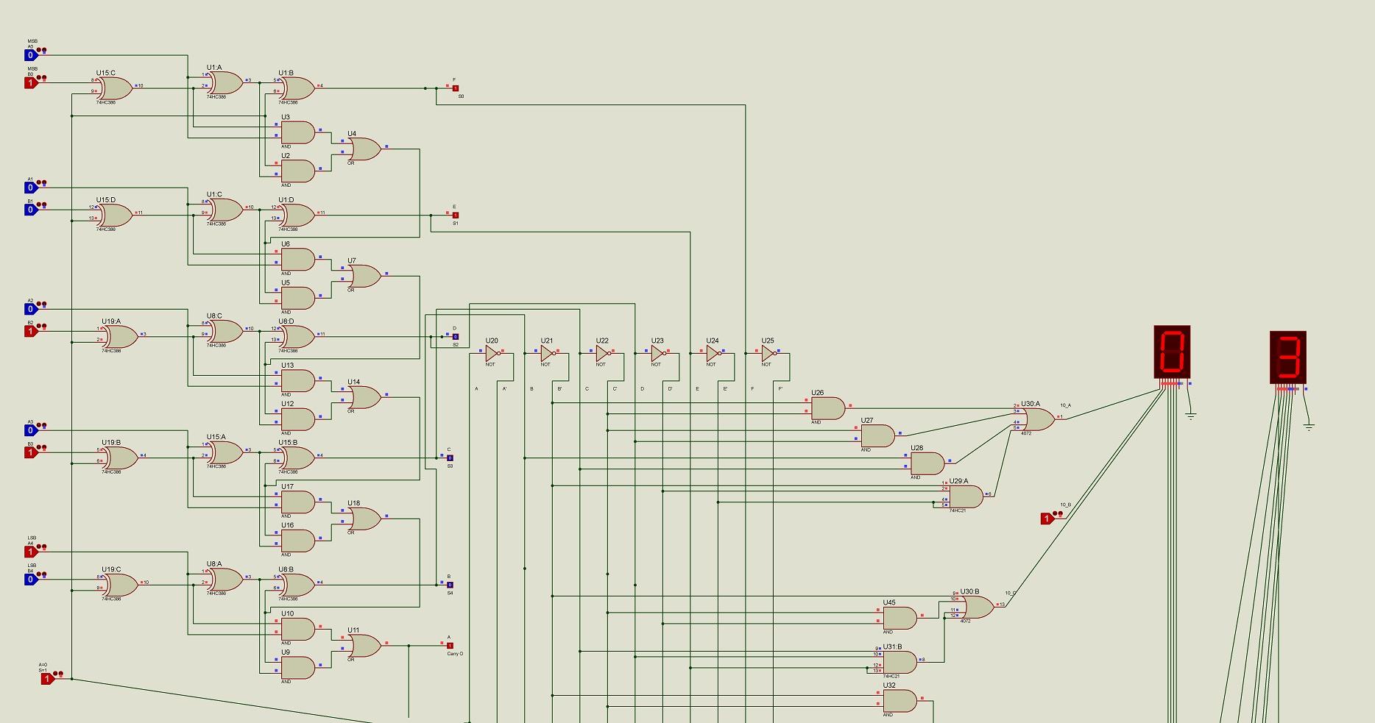

Slide 9
Thank You

